Slide 1

MEDIA & THE PUBLIC
Week 11 Active and Incidental News Exposure on Social Media
Ryan Wang
ryanyang@psu.edu

Slide 2
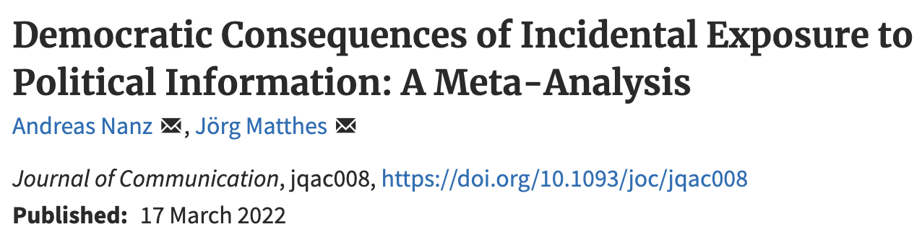
The democratic consequences of incidental news exposure (Nanz & Matthes, 2020)
Further news use (positive)
Largest effect size for social media news use, then online news uses and offline news use
learning of political information (political knowledge)
Second-level incidental exposure may lead to more substantial learning (positive)
Political participation
Higher level of political knowledge is connected to higher level of political participation (positive)
The relationship between incidental exposure and online political participation is stronger than the relationship between IE and offline political participation.
Expressive engagement
Sharing political news or opinion expression on social media (positive)
The relationship of incidental exposure with offline expression was significantly smaller than the one with online expression and sharing
Political discussion (positive)
Notes:
106 distinct independent samples.

Slide 3
Oeldorf-Hirsch, A. (2018) The Role of Engagement in Learning From Active and Incidental News Exposure on Social Media

Slide 4
Background
Elaboration mediation model
The relationship between news use motivations and resulting political knowledge is mediated by the cognitive processes of attention and elaboration
Surveillance gratifications drive attention to news media
Attention to news media leads to elaborative processing
These cognitive processes lead to greater political knowledge
News media attention
Surveillance gratification sought
Political knowledge
Elaboration processing

Slide 5
Elaboration mediation model
Cognitive processes
Attention: the focus of mental effort on information
Physiological measure: Electroencephalography
Behavioral measure: Eye-tracking
Proxy measure on social media: engagement through interactive feature (like, comment/reply, share/retweet, etc.
Elaboration: “connecting new information to other information stored in the memory, including prior knowledge, personal experiences, or the connection of two new bits of information together in new ways” (Eveland, 2001, p.273)
Notes:
Recall news later and think about it;

Slide 6
Measurement
Dependent variable
Current event knowledge
12 multiple-choice questions from Pew Research Center’s 2014 News IQ Quiz about national and international events that are being discussed in the U.S. news media at the time (13.37 minutes; M = 127.74, SD = 87.54)
“What does the term ‘Common Core’ refer to?”
“On which of these activities does the U.S. government currently spend the most money?”
“Who is the current Prime Minister of Israel?”
Independent variables
Active news seeking (from 12 news sources: 1 to 7; never to several times per day)
Facebook news seeking (M = 3.77, SD = 2.21)
Twitter news seeking (M = 2.79, SD = 2.02)
Incidental news exposure f(om 12 news sources: 1 to 7; never to several times per day)
Facebook news exposure (M = 4.45, SD = 2.08)
Twitter news exposure (M = 3.16, SD = 2.23 )

Slide 7
Measurement
Mediators
Social media news engagement (1 to 7; never to several times per day)
How often they post, read, like, comment on, and reshare news stories on Facebook (α = .93, M = 3.21, SD = 1.77)
How often they post, read, like, reply to, and retweet news stories on Twitter (α = .95, M = 2.15, SD = 1.63)
Cognitive elaboration (1 to 7; strongly disagree to strongly disagree)
What did respondents do after reading a news story
“I think about what should be done”
“I think about what this mean to other people”
“I think about how the story relates to

Slide 8
Hypotheses
Active news seeking
H1: Actively seeking news content on social media will be positively related to current events knowledge.
H2: Actively seeking news content on social media will be positively related to engagement with that news content on social media.
H3: Actively seeking news content on social media will be positively related to elaboration about the news.
H4: Social media use for news will be positively associated with political persuasion on social media both directly, and indirectly, through network heterogeneity and discussion disagreement.
H5: Engagement in news content will be positively related to elaboration about the news.

Slide 9
Hypotheses
Incidental news exposure
H6: Incidental exposure to news content on social media will be positively related to current events knowledge.
H7: Incidental exposure to news content on social media will be positively related to engagement.
RQ1: What is the relationship between incidental exposure to news content on social media and elaboration?
RQ2: Will the relationship between incidental news exposure and knowledge be mediated by engagement and elaboration?

Slide 10
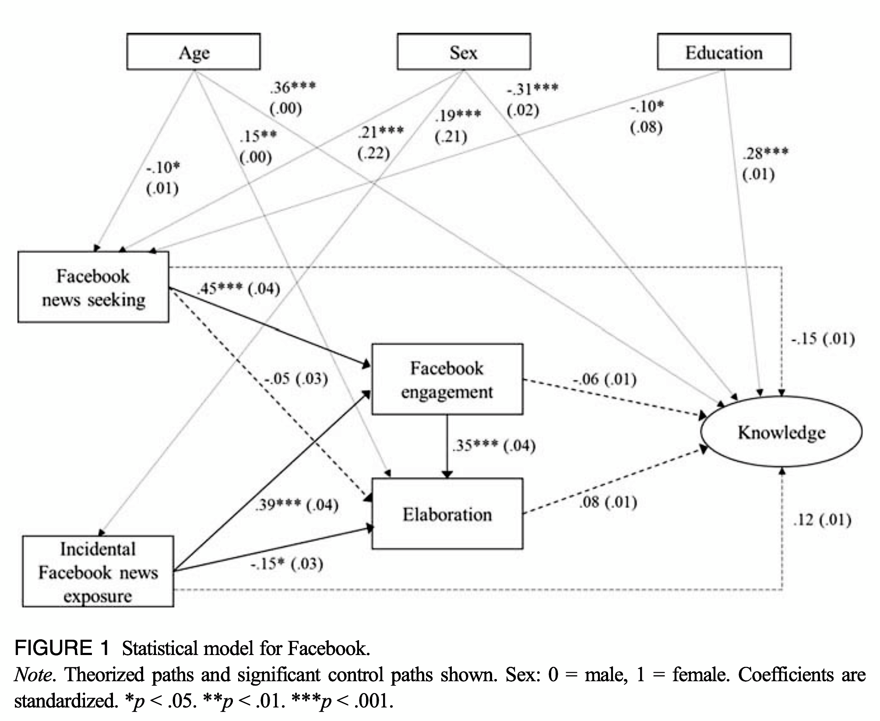
Results
H1
H2
H5
H3
H4
H7
RQ2
RQ1
H6
Notes:
Lagged regression model

Slide 11
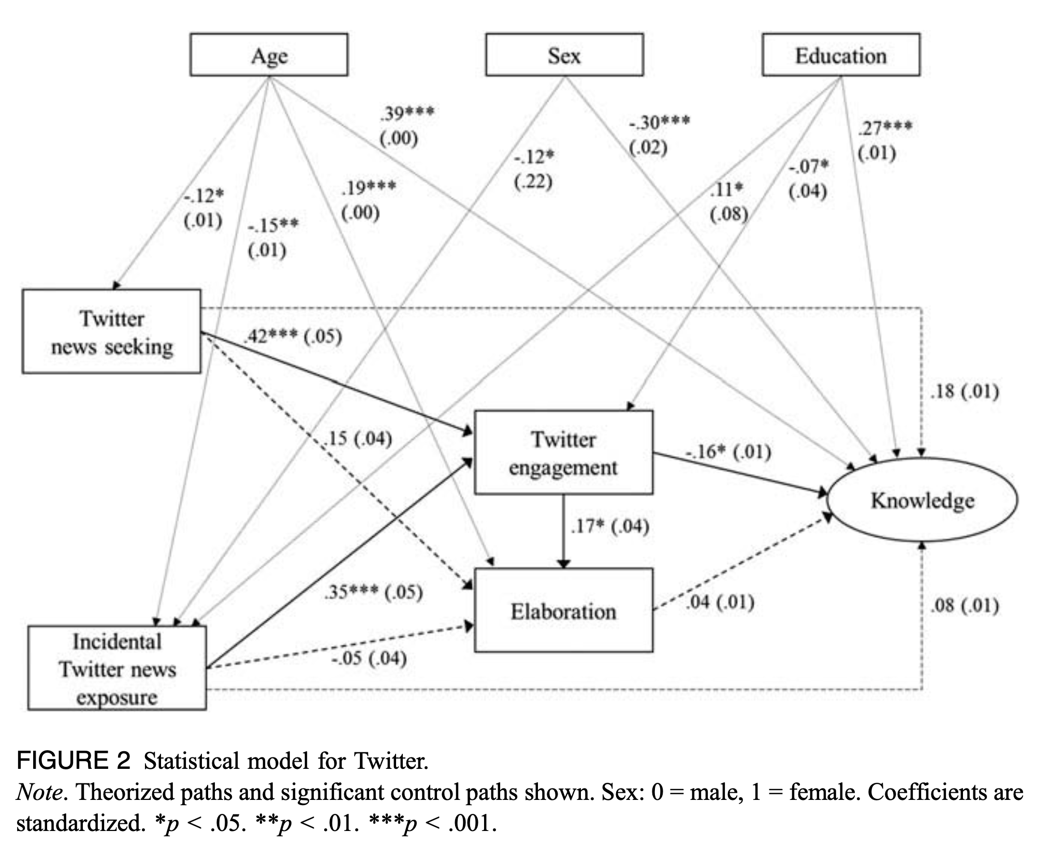
Results

Slide 12
Key takeaways
Main findings supporting hypotheses
Both actively seeking news and incidental exposure to news are positively related to engagement in news content,
Higher level of engagement predicts great cognitive elaboration about the content
Engagement with social media news content mediates the relationship between active news seeking and elaboration, and between incidental news exposure and elaboration. Engagement is important for incidental exposure on Facebook
Main findings on research questions
Knowledge is not the key outcome of engaging with news content on social media sites
Engagement and elaboration do not mediate the relationship between news seeking and current events knowledge
Cognitively elaborating on the news and learning from it may be two separate processes on social media
Engaging in shared news content on social media takes on a social function that redirects users away from the facts in a news story toward a variety of interactions about the topic.
Notes:
Testing it the cognitive mediation model in social media context; bring incidental news exposure

Slide 13
Reference
Eveland Jr, W. P. (2001). The cognitive mediation model of learning from the news: Evidence from nonelection, off-year election, and presidential election contexts. Communication research, 28(5), 571-601. https://doi.org/10.1177/009365001028005001
Nanz, A., & Matthes, J. (2022). Democratic Consequences of Incidental Exposure to Political Information: A Meta-Analysis. Journal of Communication. https://doi.org/10.1093/joc/jqac008

